Slide 1
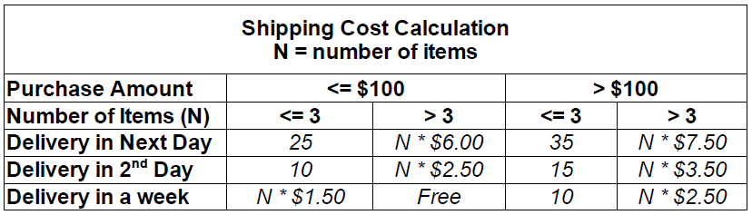
Assignment 1
due 16.10.2012, 17:00
Assume that a shipping company wants you to write a Java program that stores the items to be shipped for each shipment along with their costs and calculates the shipping cost using the following decision table.

